Slide 1
DATA EXTRACTION
Abhijit Ramesh Patil

Slide 2
1. What is data extraction
“Data extraction is the process of retrieving or collecting information (usually unstructured or poorly structured) from different sources for further data processing or data storage or analysis.”
Eg. Extracting phone number from digital directory.

Slide 3
2. Why data extraction is important
Data extraction is important because of following points :
Organise data from different sources into a centralized location
To summarize study in format
To identify missing or incorrectly assessed data
To achieve more accurate results
Easier access to information
To achieve big goals
It helps to improve productivity, save time, reduce cost

Slide 4
3. What are the steps in ETL process
1) Extraction : It involves selecting and collecting necessary data needed for analytical processing into staging area. Staging area gives an opportunity to validate extracted data before it moves into data warehouse
There are 3 extraction methods
1) Full extraction
2) Partial extraction (Without update notification)
3) Partial extraction (With update notification)
2) Transformation :
In this step customised operations are performed on the extracted data. This is nothing but cleaning of extracted data. Data that does not require any transformation is called direct move or pass through data

Slide 5
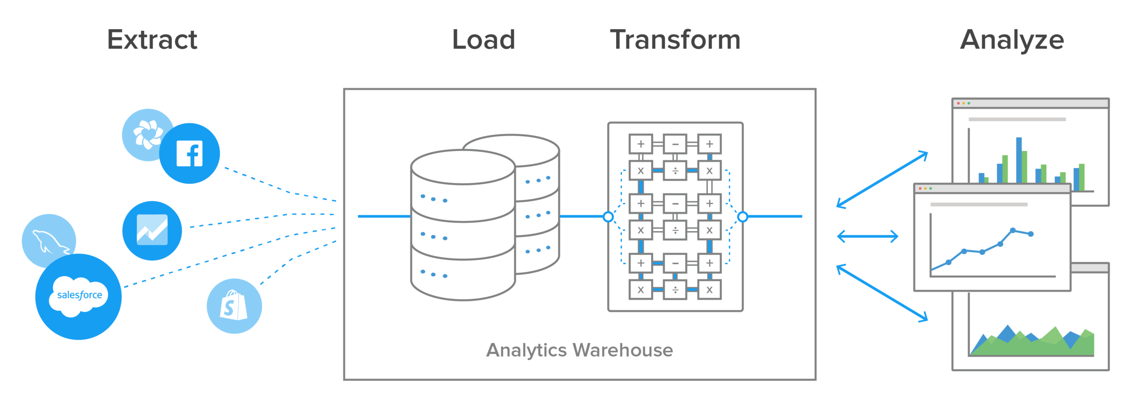
3) Loading :
This is the last step of ETL where data is loaded or stored into target Datawarehouse.
Types of loading
1) Initial load
2) Incremental load
3) Full refresh

Slide 6
4. What are different types of extraction
1) Full extraction :
In full extraction data is completely extracted from source and there is no need to track changes.
It involves high data transfer
2) Incremental extraction :
Extracting data that has been changed or added after well defined event in the source database
Limitation of incremental extraction is that it may not be able to detect the deleted record in the source record

